Slide 1
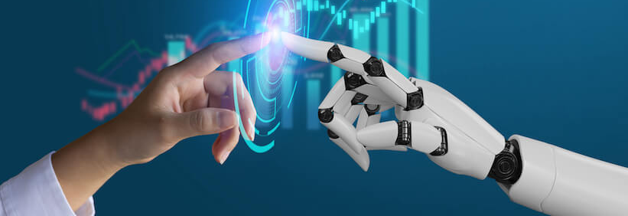
Houston Community College
ITAI 1378 Computer Vision
Professor Patricia McManus
August 28, 2024
Historical Timeline Of Computer Vision
The 2000s
Shakira Kashif
Devin Prikryl-Martin
Christian Mpabuka
Piero Suarez Prada

Slide 2
Computer Vision in the New Millenium
CNNs for Image Recognition
Google Brain
RCNN
YOLO
SIFT
ImageNet
AlexNet
AI4ALL
2004
2006
2009
2011
2012
2014
2015
2016

Slide 3
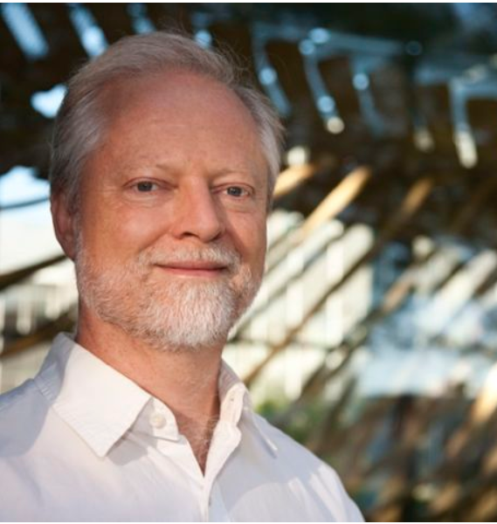
David Lowe- Sift (2004)
David Lowe is Professor Emeritus with the Computer Science Department of the University of British Columbia. From 2015-2018, David Lowe was a Senior Research Scientist with Google in the Machine Intelligence Group. From 2009-2015 he was co-founder and chairman of Cloudburst Research, a computer vision startup in Vancouver that was acquired by Google in May 2015. From 1987-2015, he was a professor of computer science at the University of British Columbia. From 1984-87, he was an assistant professor of computer science at the Courant Institute of Mathematical Sciences of New York University.
David Lowe was awarded the Helmholtz Prize at the International Conference on Computer Vision in 2011 and 2017, and the PAMI Distinguished Researcher Award in 2015. His research interests include computer vision, machine learning, and computational models of the brain.
The development of the SIFT algorithm marked a significant advancement in computer vision. Introduced by David Lowe in 1999, it was designed to detect and describe local features in images. The primary goal of SIFT is to extract distinctive features from images that are invariant to scaling, rotation, and partially invariant to changes in illumination and 3D camera viewpoint. These features provide a robust basis for tasks like object recognition, image stitching, and 3D modeling. Scale-Invariant Feature Transform (SIFT) is an influential algorithm in the field of computer vision and image processing. The essay will cover various aspects of SIFT, including its development, core principles, functionality, applications, advantages, and limitations.
Citations
. David G Lowe Retrieved August 28.2024. From https://www.cs.ubc.ca/
.Published by Everton Gomede, PhD
SIFT (Nov, 28, 2023) https://python.plainenglish.io/
Notes:
By Christian Mpabuka

Slide 4
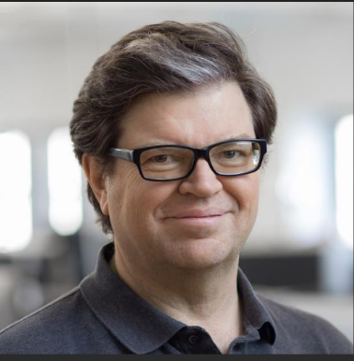
Yann Lecun- Convolutional Neural Networks For Image Recognition (2006)
Yann is Chief AI Scientist for Facebook AI Research (FAIR), joining Facebook in December 2013. He is also a Silver Professor at New York University on a part time basis, mainly affiliated with the NYU Center for Data Science, and the Courant Institute of Mathematical Sciences.
He made neural networks convolutional, Along with Geoffrey Hinton and Yoshua Bengio, LeCun is referred to as one of the “three musketeers” of deep learning. Like them, LeCun pushed the idea that artificial neural networks that imitate the human brain would allow computers to develop skills that could not be otherwise programmed manually. He did so facing stiff resistance from the computer science establishment, which had long ago disregarded the concept of artificial neural networks as the stuff of science-fiction.
LeCun is widely credited for advancing convolutional neural networks. Beginning in the late 80’s he proposed architecture for building neural networks that would help computers recognize images. In 1994, while working at AT&T Bell Labs, he finally created one that was able to identify handwritten characters. By 1998, banks were using the technology to read more than 10% of all checks in the U.S.
Throughout the 1990’s and 2000’s Le Cun continued to pioneer the use of CNN to recognize objects, including cars, animals, and human faces.
Like his two fellow musketeers, LeCun has long divided his time between academia and private enterprise. Since 2003, he has been a professor at New York University and in 2012 he founded the NYU Center for Data Science.
In 2013, Facebook hired LeCun to run its newly-established AI research division. After four years however, LeCun stepped down from the management role so that he could devote himself to research as the company’s chief AI scientist. Under LeCun’s leadership, Facebook has boasted a number of important AI innovations.
Citations
. Yann LeCun: An Early AI Prophet - History of Data Science Retrieved August 28,2024 from https://www.historyofdatascience.com/
. Yann LeCun Retrieved August 28,2024 from https://ai.meta.com/
Notes:
By Christian Mpabuka

Slide 5
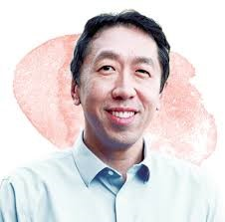
Andrew NG: GoogleBrain
A key figure in AI and machine learning, co-founder of Google Brain and Coursera. Ng's work in deep learning and AI education has significantly shaped the field.
Co-founded Google Brain, which led to breakthroughs in AI, especially in computer vision, NLP, and speech recognition. Famous for training neural networks to recognize cats from YouTube videos without human labels, showcasing the power of unsupervised learning.
Applied deep learning to image recognition, advancing facial recognition, object detection, and medical imaging. His work influenced autonomous vehicles, robotics, and more.
Co-founded Coursera and launched a Machine Learning course that democratized AI education, training millions globally.
Advocates for ethical AI and founded Landing AI to bring AI into healthcare and manufacturing. Previously, he led AI at Baidu, focusing on NLP and computer vision.
Citations:
Ng, A. (n.d.). About Andrew Ng. Retrieved August 28, 2024, from https://www.andrewng.org/about/
Stanford Human-Centered AI. (n.d.). Andrew Ng. Retrieved August 28, 2024, from https://hai.stanford.edu/people/andrew-ng
Notes:
By Shakira Kashif

Slide 6
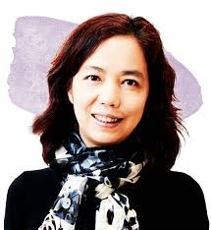
Fei-Fei Li- Imagenet
Known for creating ImageNet, Fei-Fei Li is a trailblazer in AI and computer vision. Her work with large-scale image datasets revolutionized the field and shaped modern AI.
Li created ImageNet, a massive labeled dataset used to train and evaluate deep learning algorithms in image classification and object detection. The 2012 AlexNet victory on ImageNet sparked the deep learning revolution in computer vision.
Li advanced deep learning in computer vision, influencing image classification, object recognition, scene understanding, and video analysis.
Co-founded Stanford’s Human-Centered AI Institute, advocating for ethical AI that benefits society. She also led AI for healthcare, enhancing medical imaging and diagnosis.
Google Cloud (2017–2018) - As Chief Scientist of AI/ML at Google Cloud, Li helped expand AI tools for businesses, focusing on image analysis and natural language processing.
Advocates for women and underrepresented minorities while emphasizing the need for ethical AI focused on fairness, privacy, and societal impact.
Li's ImageNet transformed computer vision, enabling advances in object recognition, facial recognition, and autonomous vehicles.
Recognized as one of TIME’s 100 Most Influential People, Li's work continues to shape AI and computer vision, focusing on socially responsible technology development.
Citations:
Stanford University School of Engineering. (n.d.). Fei-Fei Li. Stanford University. Retrieved August 28, 2024, from https://profiles.stanford.edu/fei-fei-li
Stanford HAI. (n.d.). Fei-Fei Li. Stanford University Human-Centered AI (HAI). Retrieved August 28, 2024, from https://hai.stanford.edu/people/fei-fei-li
Notes:
By Shakira Kashif

Slide 7
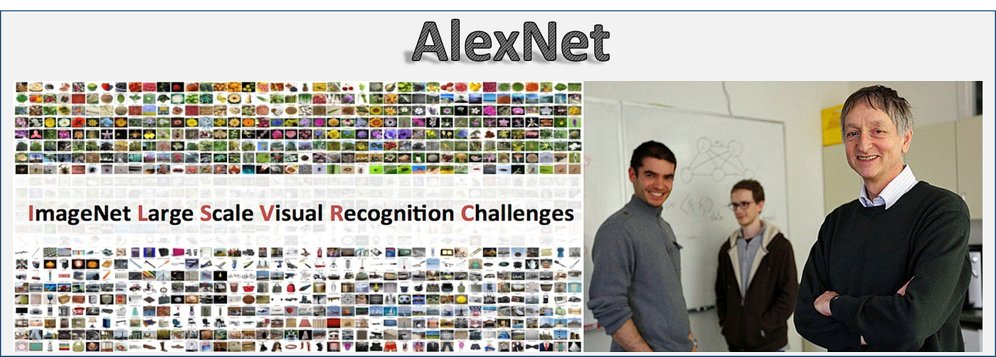
Alex Krizhevsky, Ilya Sutskever, and Geoffrey Hinton- Alexnet (2012)
Alexnet is a convolutional neural network (CNN) architecture created by Alex Krizhevsky, Ilya Sutskever, and Geoffrey Hinton.
Convolutional neural networks use three-dimensional data for image classification and object recognition tasks.
AlexNet is an amazing model capable of accurately identifying sets of information. AlexNet's tremendous performance for object detection tasks places it in a high position for application in computer vision problems of artificial intelligence.
Citations
What are convolutional neural networks?. IBM. (2021, October 6). https://www.ibm.com/topics/convolutional-neural-networks
Khawlajlassi. (2021, February 7). Deep Convolutional Neural Networks (AlexNet). Medium. https://khawlajlassi.medium.com/deep-convolutional-neural-networks-alexnet-278595709aac
Notes:
By Piero Suarez Prada

Slide 8
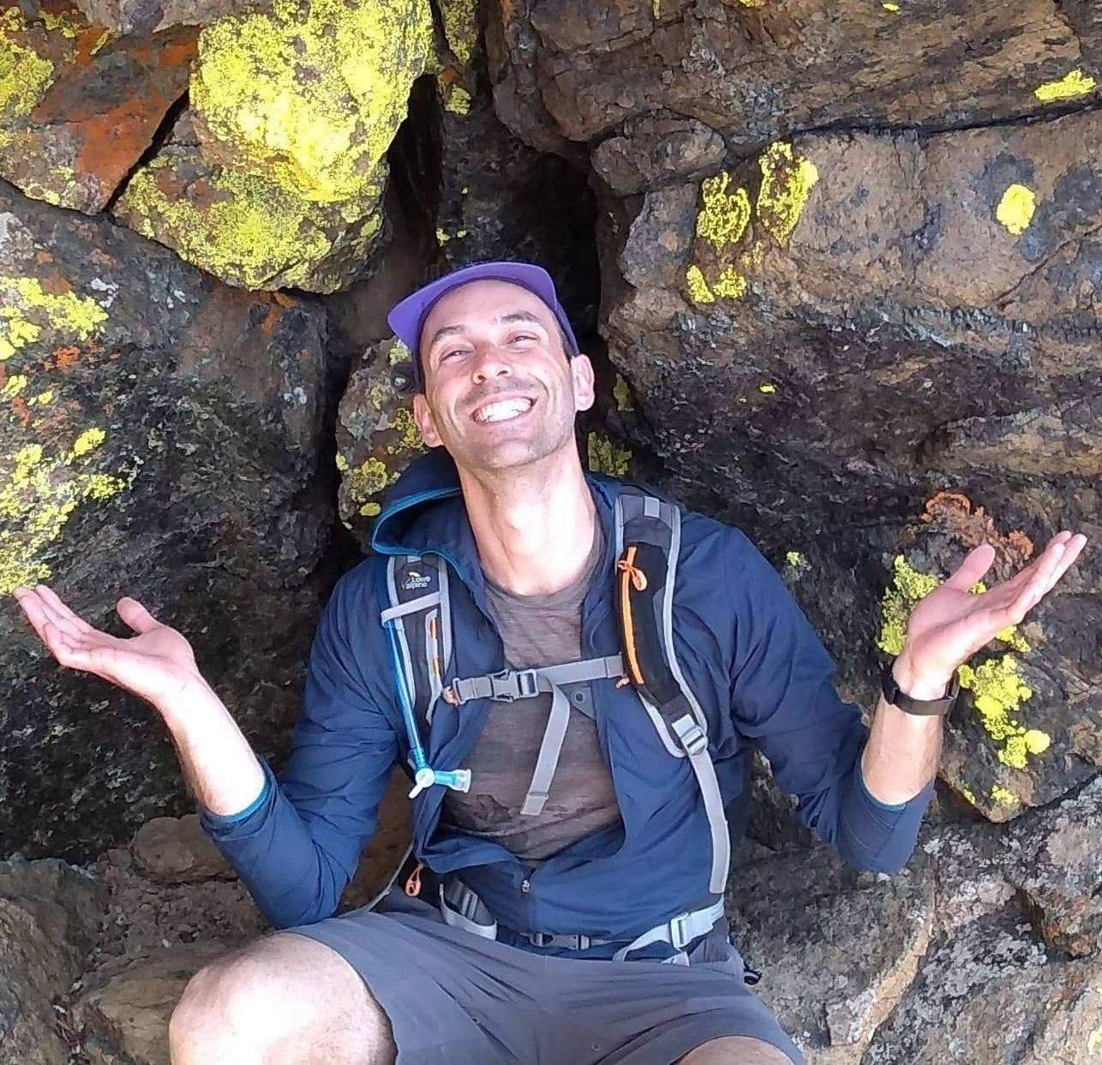
Ross Girshick-RCNN (2014)
Ross Girshick is a researcher who earned a PhD in computer science from the University of Chicago and a postdoc at the University of California.
Ross was a researcher at Microsoft Research for one year and also served on Meta's Fundamental Artificial Intelligence Research (FAIR) team for eight years. He is currently a Distinguished Research Fellow at the Allen Institute for Artificial Intelligence (AI2).
Ross developed the R-CNN approach for object detection.
Region-based Convolutional Neural Network (R-CNN) is a type of deep learning architecture used for object detection in computer vision tasks. This pioneering model helped advance the field of object detection by combining the power of convolutional neural networks and region-based approaches.
Citations
Petru Potrimba. (Sep 25, 2023). What is R-CNN?. Roboflow Blog: https://blog.roboflow.com/what-is-r-cnn/
RBG's Home Page https://www.rossgirshick.info/#:~:text=Ross%20is%20well%2Dknown%20for,Prize%20at%20ICCV%20in%202017.
Notes:
By Piero Suarez Prada

Slide 9
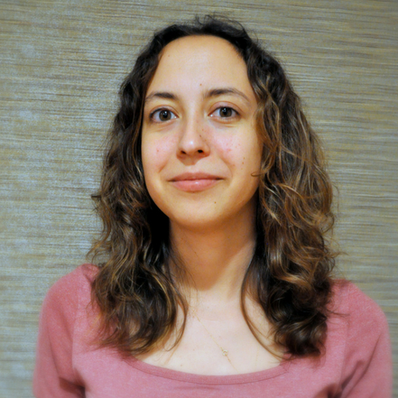
Olga Russakovsky- Ai4all (2015-Present)
Dr. Olga Russakovsky is an Assistant Professor of Computer Science at Princeton University. Her background in Computer Vision research led her to pursue a major problem she saw developing in AI, namely that a lack of diversity in the data being used to train AI models leads to biased outcomes. 2015 saw the inception of her idea for a non-profit aimed at addressing diversity of representation and information inside the realm of AI. Under the guidance of her advisor, Fei-Fei Li, another prominent figure in the field of Computer Vision, Dr. Russakovsky co-founded AI4ALL. This organization, which has only grown in scope and achievement since it began nearly 10 years ago, brings together groups of high school and college students who are historically underrepresented in the AI space, and provides learning tools, connections and community. The participants of AI4ALL often pursue a career in AI and many have made significant contributions to the advancement of AI, both technologically and in the realm of bias reduction.
Aside from her work with AI4ALL, Dr. Russakovsky has also made a number of technological contributions to AI, including but not limited to co-developing the Inclusive Images Dataset, proposing methods for crowdsourcing diverse image annotations, developing a framework for assessing computer vision models for demographic bias, and developing a technique called “Balanced Feature Attribution” which reduces the instances of object detection models making inaccurate correlations that lead to biased predictions.
Citations
AI4ALL. (2022, December 21). Our story. AI4ALL. https://ai-4-all.org/about/our-story/
UChicago Data Science Institute. (2021, January 25). CDAC Distinguished Speaker Series - Olga Russakovsky (Princeton) [Video]. YouTube. https://www.youtube.com/watch?v=82spfonv9DA
Notes:
By Devin Prikryl-Martin

Slide 10
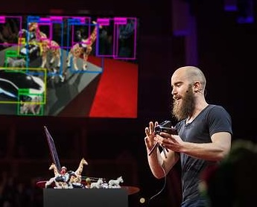
Joseph Redmon-yolo ”You only look once” (2016)
Joseph Redmon is a computer scientist and researcher who co-created YOLO, an approach to object detection that revolutionized the field of Computer Vision. YOLO stands for “You Only Look Once” and refers to the process in which the whole image is assessed only once and predicts whether an object is present, then assesses the location and size of the object and classifies what the object is. This allows YOLO to work at incredible speeds, making it possible to detect and identify objects in real-time video. Previous methods of object detection passed a window of a certain size over the image one piece at a time and scanned each frame for a probable object. YOLO approaches the issue completely differently, by breaking the image up into a grid and running the entire image through the Convolutional Neural Network at once. Each grid is assessed simultaneously, predicting the likelihood that a certain object exists inside it. The ability to detect objects in real time has allowed for massive leaps forward in the field of autonomous driving, robotics and video surveillance.
Joseph developed YOLO while working on his PhD at the University of Washington. He co-authored the paper You Only Look Once: Unified, Real-Time Object Detection alongside Santosh Divvala, Ross Girshick and Ali Farhadi. He continued on to release several updated versions of YOLO, all of which were released opensource. He has since taken steps away from the field of Computer Vision in ethical objection to the misuse of the technology, especially as it relates to the creation of autonomous weapons and mass civilian surveillance.
Citations
TEDx Talks. (2018, June 13). Computers can see. Now what? | Joseph Redmon | TEDxGateway [Video]. YouTube. https://www.youtube.com/watch?v=XS2UWYuh5u0
Redmon, J., Divvala, S., Girshick, R., & Farhadi, A. (2016). You Only Look Once: Unified, Real-Time Object Detection. Retrieved from https://www.cv-foundation.org/openaccess/content_cvpr_2016/papers/Redmon_You_Only_Look_CVPR_2016_paper.pdf
Notes:
By Devin Prikryl-Martin

